Slide 1
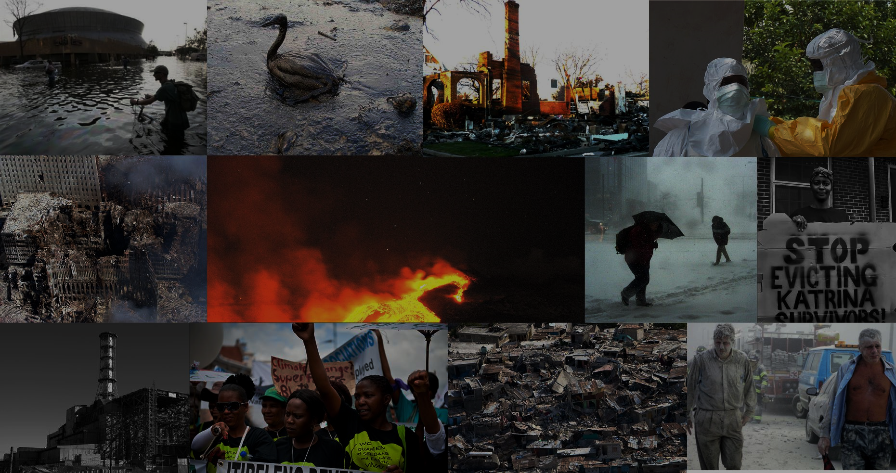
Social Studies
Presentation

Slide 2
ACKNOWLEDGEMENT
We would like to express our deepest gratitude to everyone who contributed to the successful completion of this group project. This endeavor was made possible through the collaborative efforts , hardwork and dedication of each team member.
We would also like to thank our SST teacher Dr. Praveen Hamid who gave us this golden oppourtunity to make this project.

Slide 3
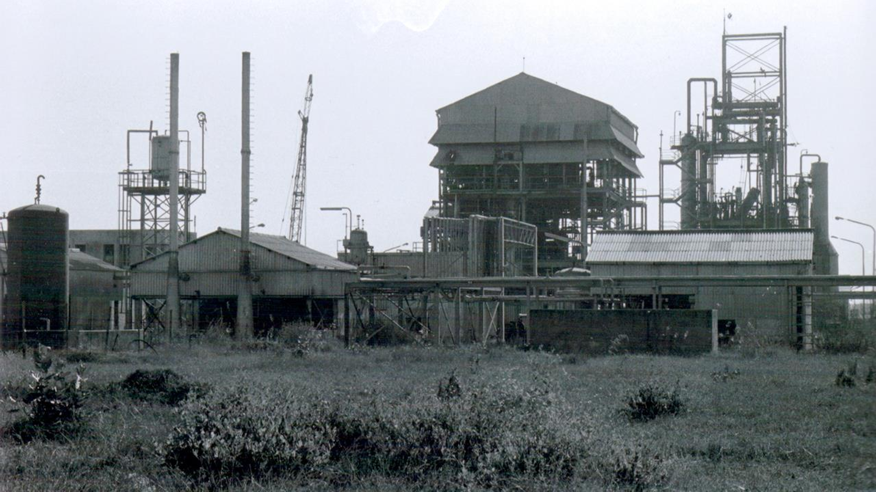

OVERVIEW ON THE BHOPAL GAS TRAGEDY
BIGGEST INDUSTRIAL DISASTER IN
HISTORY

Slide 4
PRESENTED BY GROUP A

Slide 5
AGENDA:-
Overview of the Bhopal gas tragedy
Background
Liquid MIC storage
Gas leakage
Effects caused
The aftermath/repercussions
Conclusion

Slide 6
OVERVIEW
The Bhopal disaster or Bhopal gas tragedy was a chemical accident on the night of 2–3 December 1984 at the Union Carbide India Limited (UCIL) pesticide plant in Bhopal, Madhya Pradesh, India.
It is considered as the world's worst industrial disaster, over 500,000 people in small towns around the plant were exposed to the highly toxic gas methyl isocyanate(MIC).The official number of immediate deaths were 2,259.
The owner of the factory, UCIL, was majority-owned by the Union Carbide
Corporation (UCC) of the United States.

Slide 7
BACKGROUND
The UCIL factory was built in 1969 to produce the pesticide Sevin (UCC's brand name for carbaryl) using methyl isocyanate (MIC) as an intermediate. An MIC production plant was added to the UCIL site in 1979.
The chemical process employed in the Bhopal plant
had methylamine reacting with phosgene to form MIC, which was in turn reacted with 1-naphthol to form the final product, carbaryl.
In the early 1980s, although the demand for pesticides had fallen, production continued leading to an accumulation of unused MIC at the Bhopal site.

Slide 8
Liquid MIC Storage
The Bhopal UCIL facility housed three underground 68,000 litre (18,000 US gal) liquid MIC storage tanks: E610, E611, and E619. In the months leading up to the December leak, liquid MIC production was in
progress and being used to fill these tanks. UCC safety regulations specified that no one tank should be filled more than 50% (about 30 tons) with liquid MIC. Each tank was pressurized with inert nitrogen gas.
In late October 1984, tank E610 lost the ability to effectively contain most of its nitrogen gas pressure, which meant that the liquid MIC contained within could not be pumped out. At the time of this failure, tank E610 contained 42 tons of liquid MIC.

Slide 9
GAS LEAKAGE
By early December 1984, most of the plant's MIC related safety systems were malfunctioning and many valves and lines were in poor condition. In addition, several vent gas scrubbers had been out of service, as well as the steam boiler intended to clean the pipes.
During the late evening hours of 2 December 1984, water was believed to have entered tank E610 via a side pipe during attempts to unclog it. The tank still contained the 42 tons of MIC that had been there since late October.

Slide 10
The introduction of water into the tank resulted in a runaway exothermic reaction, which was accelerated by contaminants, high ambient temperatures, and various other factors such as the presence of iron from corroding non-stainless steel pipelines.
The pressure in tank E610, although initially nominal at 14 kilopascals (2 psi) at 10:30 p.m., reached 70 kilopascals (10 psi) as of 11 p.m. Two different senior refinery employees assumed the reading was instrumentation malfunction.
By 11:30 p.m., workers in the MIC area were feeling the effects of minor exposure to MIC gas and began to look for a leak. One was found by 11:45 p.m. and reported to the MIC supervisor on duty at the time.

Slide 11
At 12:40 a.m. the reaction in tank E610 escalated to a critical state at an alarming speed within five minutes. Temperatures in the tank were off the scale, maxed out beyond 25 °C (77 °F), and the pressure in the tank was indicated at 280 kilopascals (40 psi).
Direct atmospheric venting should have been prevented or at least partially mitigated by at least three safety devices which were malfunctioning. These were:-
A refrigeration system meant to cool tanks containing liquid MIC. 2)A flare tower to burn the MIC gas as it escaped.
3)A vent gas scrubber which had been deactivated at the time.

Slide 12
About 30 tonnes of MIC escaped from the tank into the atmosphere in 45 to 60 minutes. This would increase to 40 tonnes within two hours. The gases were blown in a southeast direction over Bhopal.
A UCIL employee triggered the plant's alarm system at 12:50 a.m. as the concentration of gas in and around the plant became difficult to tolerate.
The MIC gas leak emanating from tank E610 petered out at approximately 2:00 a.m. Fifteen minutes later, the plant's public siren was sounded for an extended period of time after having been quickly silenced an hour and a half earlier.
Most city residents who were exposed to the MIC gas were first made aware of the leak by exposure to the gas itself, or by opening their doors to investigate commotion, rather than having been instructed to shelter in place or to evacuate before the arrival of the gas in the first place.

Slide 13
EFFECTS CAUSED
The initial effects of exposure were coughing, severe eye irritation, a feeling of suffocation, burning in the respiratory tract, breathlessness, stomach pains, and vomiting.
Thousands of people had died by the following morning. Primary causes of deaths were choking, reflexogenic circulatory collapse, pulmonary oedema, tubular necrosis of the kidneys, fatty degeneration of the liver etc.
The individuals who did not die suffered from cancer, blindness, loss of livelihood, and financial strain.

Slide 14
THE AFTERMATH
In the immediate aftermath, the plant was closed to outsiders (including UCC) by the Indian government, which subsequently failed to make data public, contributing to the confusion.
The UCC chairman and CEO Warren Anderson, together with a technical team, immediately travelled to India. Upon arrival, Anderson was placed under house arrest and urged by the Indian government to leave the country within 24 hours. Union Carbide organized a team of international medical experts, as well as supplies and equipment, to work with the local Bhopal medical community, and the UCC technical team began assessing the cause of the gas leak.

Slide 15
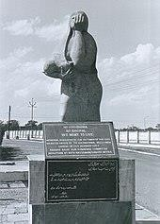
The health care system immediately became overloaded. In the severely affected areas, nearly 70% of doctors were underqualified. Medical staff were unprepared for the thousands of casualties. Doctors and hospitals were not aware of proper treatment methods for MIC gas inhalation.
Within a few days, trees in the vicinity became barren, and bloated animal carcasses had to be disposed of. 170,000 people were treated at hospitals and temporary dispensaries, and 2,000 buffalo, goats, and other animals were collected and buried. Supplies, including food, became scarce owing to suppliers' safety fears. Fishing was prohibited, causing further supply shortages.
Memorial to those killed and disabled in Bhopal by Dutch Holocaust survivor- Ruth Waterman

Slide 16
CONCLUSION
The official immediate death toll was 2,259, and in 1991, 3,928 deaths had been officially certified. The Sambhavna clinic "estimates 8,000 deaths during the first weeks, and another 8,000 since then".
The government of Madhya Pradesh confirmed a total of 3,787 deaths related to the gas release.
Bhopal now has high rates of birth defects and records a miscarriage rate 7x higher than the national average.
An estimated 120,000 to 150,000 survivors still struggle with serious medical conditions including nerve damage, growth problems, respiratory issues, birth defects, and elevated rates of cancer and tuberculosis.

Slide 17
PART – 2
The Gulf of Mexico oil spill
2010

Slide 18

WHAT SHOULD BP HAVE DONE BEFORE AND AFTER The Gulf Disaster ?
THE HORRIFIC INDUSTRIAL DISASTER

Slide 19
PRESENTED BY GROUP A

Slide 20
AGENDA
Overview of BP and the Gulf disaster
Ryskin’s Methane Extinction Theory
Before
BP’s Action
Ethical Issues
Alternatives
Recommendations
After
BP’s Action
Ethical Issues
Alternatives
Recommendations
Conclusion

Slide 21
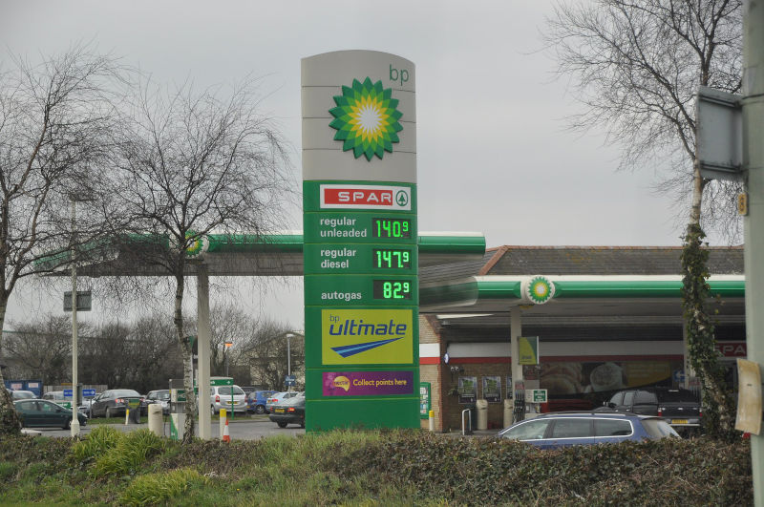
BRITISH PETROLEUM

Slide 22
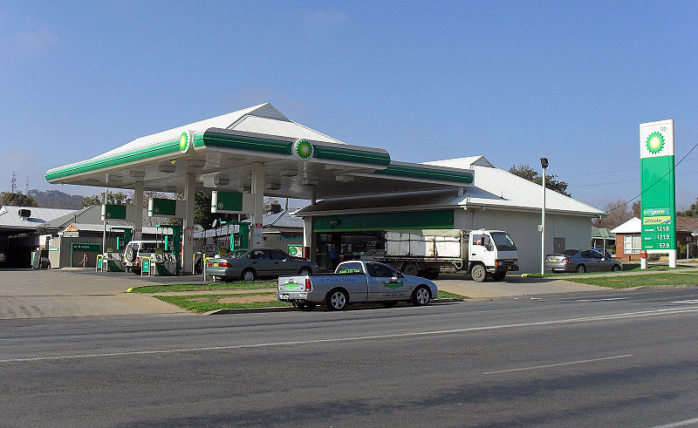
British Petroleum
BP is a global oil and gas company
Fourth largest company in the world
BP operates in over 80 countries producing about 3.8 million barrels of oil per day servicing 22400 stations

Slide 23
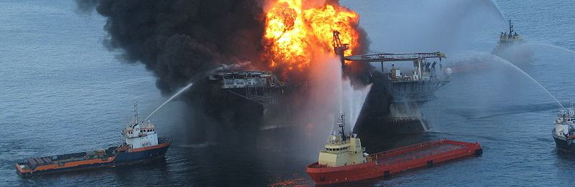
Gulf Disaster
On April 20, 2010, there was a explosion on BP’s drilling rig “Deepwater Horizon” in the Gulf of Mexico, near Louisiana
The oil spill caused the second largest environment disaster in U.S. history

Slide 24
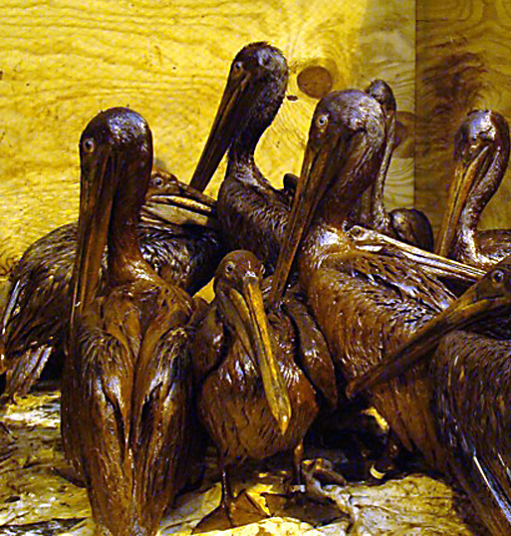
Additional Info
The well was officially sealed 19 September 2010 (5 Months)
Total of about 4,900,000 barrels (779,794,828L), peaking 62,000 barrels per day were spilled. Crude oil is at about $100 per barrel
An area of 180,000km squared was covered affecting 50% of the 16,000 species in the Gulf of Mexico
Birds covered in crude oil

Slide 25
Stakeholders
British Petroleum
Transocean
U.S. government
Workers
Residents
World Population

Slide 26
The Hidden Problem
Ryskin theorized that:
“251 million years ago a mammoth undersea methane bubble caused massive explosions. This poisoned the atmosphere and destroyed more than 96 percent of all life on Earth”
“55 million years later another methane bubble ruptured causing more mass extinctions”

Slide 27
The Hidden Problem
Ryskin’s methane extinction theory states that “BP’s Deepwater Horizon drilling operation may have triggered an irreversible, cascading geological Apocalypse that will culminate with the first mass extinction of life on Earth in many millions of years.”

Slide 28
The Hidden Problem
“The oceans periodically produce massive eruptions of explosive methane gas. However small amounts are never noticeable.”
“BP drilled down miles into a geologically unstable region and may have set the stage for the eventual premature release of a methane mega-bubble.”

Slide 29
The Hidden Problem
“Methane levels in the water are now calculated as being almost one million times higher than normal.”
“If a mega methane bubble ruptures any life near the epicenter will die instantly.”
“Next, the ocean bottom would collapse, causing major tsunamis.”

Slide 30
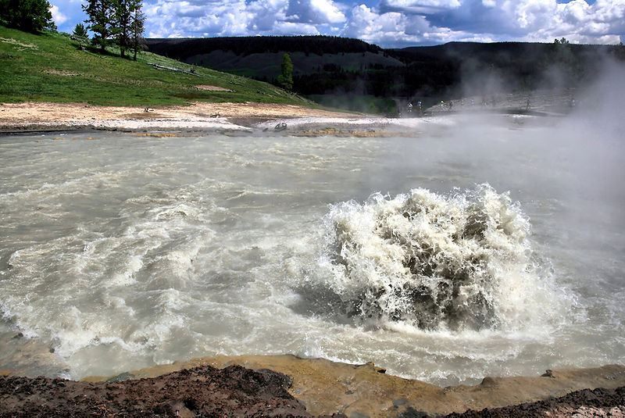
What caused the explosion?
Abnormal pressure caused a methane bubble
Methane gas escaped from the well and ignited
The explosion was sudden, it took less than five minutes for the rig to ignite on fire.
Methane Bubble

Slide 31
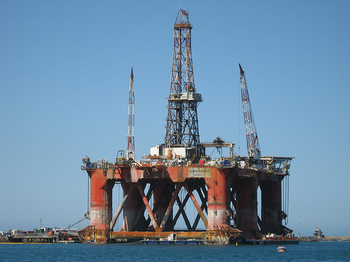
Before the Gulf Disaster

Slide 32
Pre-explosion Problems
There had been several small fires and spills at Deepwater Horizon
The metal casing was known to have issues in 2009 and BP was warned that it could collapse under high pressure.
BP officials rejected a safety proposal to install casing liner and casing stabilizers which cost $7 million and 10+ hour of labour.
In an email BP engineer Brian Morel called Deepwater a "nightmare rig" due to these cavalier safety risks.

Slide 33
Red Flags and Warnings
They often switched from a drilling rig to a production rig, and vice versa. In order to do so, the bottom of the hole needed to be sealed with a cement plug, called a shoe.
To shut down the well a series of “casing integrity tests” was done. This ensures that there is no pressure leaking.
BP encountered 3 problems.

Slide 34

Red Flags and Warnings
When the crew tried to fit a top plug, it did not sit properly. This clearly indicated that the bottom cement seal could be leaking pressure into the well.
A failed “Negative Pressure Test”, indicated that there was pressure build up.
In a final stage of shutting down the well, the rig crew replaced the heavy drilling mud with sea water. which flowed out faster than the water, which was not normal.

Slide 35
The Ethical Issue
Modern business ethical theory and corporate responsibility emphasize the importance of taking stakeholder interests into account. BP has failed to prioritize stakeholders before and after the incident.

Slide 36

The Ethical Issue
Knowing that the Deepwater Horizon had problems, BP did not take any action
The rig continued to run under risk. Putting profit over the safety of workers.
The management of BP ignored the “Red Flags” from their procedural tests.

Slide 37
Alternatives Before
Put in the $7 Million dollar casing
Stop at the first red flag (top plug not sitting properly) and fix the problem
Ignore the warnings and continue production in the pursuit of profit.

Slide 38
Recommendation vs. Implementation
Put in the casing prior to production.
Ignore the warnings and continue production.

Slide 39
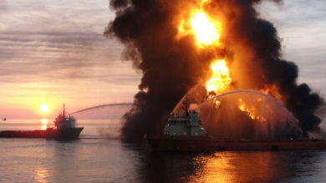
AFTERMATH

Slide 40
The Clean Up And Response
Since BP is legally responsible for the facility, they are responsible for the clean up.
BP initially stated that the company would pay for all the costs but have received $2o billion from the US government.
Restore wildlife habitat in the Gulf area
BP has started a claim facility for anyone that has been affected.

Slide 41
Claims
Total Payments to Individuals and Businesses $3,997,609,602
Payments to Government for Advances and Claims $1,190,970,633
Total Paid or Approved for Payment $5,460,306,354
The above astronomical numbers are claims and payments that BP states to have paid or will pay

Slide 42
The Ethical Issue
Empathized on external stakeholders that suffered as well from the oil spill instead of focusing on corporate liability.
BP denied independent scientists and media access to the site in an attempt to cover the truth about the situation.

Slide 43
The Ethical Issue
Wildlife and environmental groups accused BP of holding back information about the extent and impact of the growing slick, and urged the White House to order a more direct federal government role in the spill response.
BP had failed to disclose results from its tests of chemical dispersants used on the spill, and tried to withhold a video showing the true magnitude of the leak.

Slide 44
Conclusion
We think that BP should have taken a deontological approach when facing these ethical dilemmas.
Should be aware of CSR and prioritize the needs of stakeholders over profits.
They need to implement an internal policy to ensure that this does not happen again.

Slide 45
Conclusion
We think that BP should have taken a deontological approach when facing these ethical dilemmas.
Should be aware of CSR and prioritize the needs of stakeholders over profits.
They need to implement an internal policy to ensure that this does not happen again.

Slide 46





SOURCES
Wikipidea
Youtube
Google
ChatGPT
Books and Encyclopedias

Slide 47
Thank you

